Slide 1



Powered by DSP & DMP PLATFORM

Slide 2



CAUDI IS USED BY AGENCIES…
All largest agency groups use CAUDI in our core regions
Almost all agency groups have internally grown products, but use CAUDI because of local data, local presence and support

Slide 3

































…AND MORE THAN 500 CLIENTS
We maintain direct relationship with key clients
to ensure effective and lasting end-to-end relationship

Slide 4
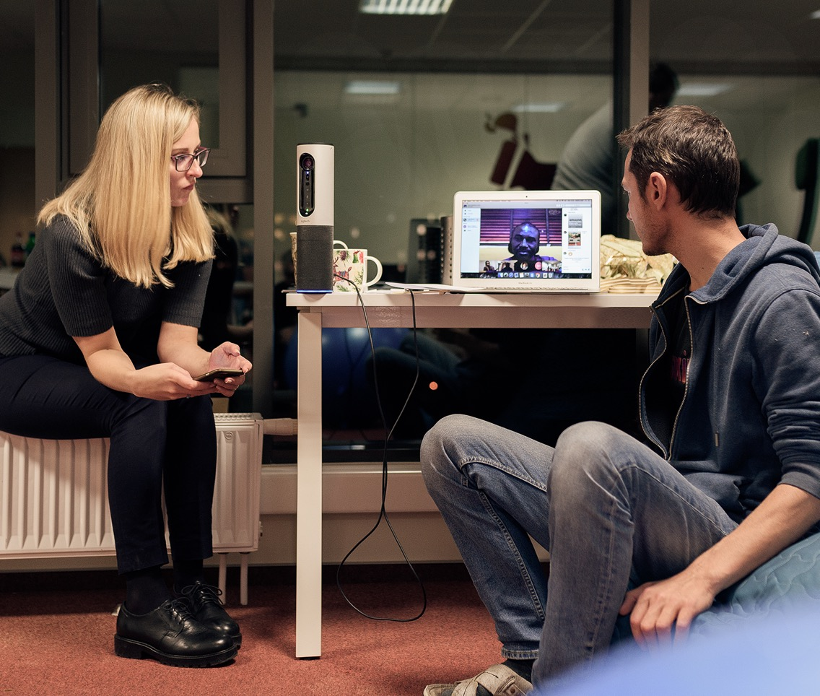
CAUDI SOLUTIONS

Slide 5

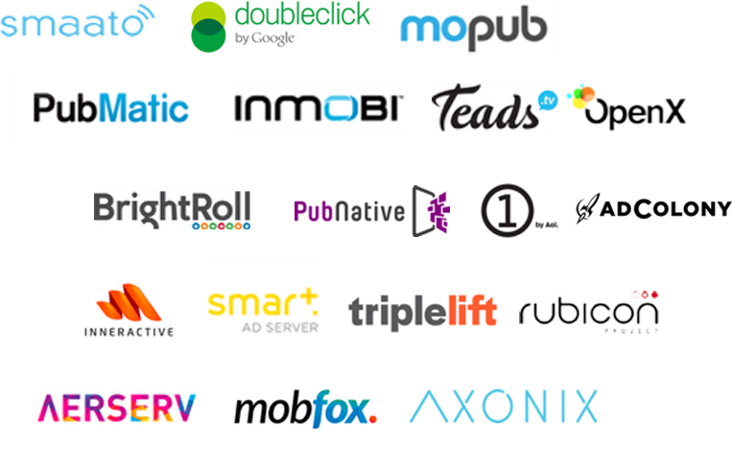
CAUDI SOLUTIONS STACK
SSP
50+ EXCHANGES
PMP
CREATIVES
DATA
SUPPLY
40 exchange sources

Slide 6

CAUDI SOLUTIONS STACK
LOCATON
DATA CONSUMPTION
CREATIVES
LOCATION TAGS
TRAVEL STATUS
LEARNING TAGS
TELECOM DATA
DATA
BROWSING BEHAVIOUR
DEVICES
FIRST PARTY DATA
EXTERNAL DATA
SUPPLY

Slide 7



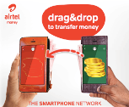
CAUDI SOLUTIONS STACK
DYNAMIC ADS
DMP LINK
CLICK TO ACTION
CREATIVES
40+ EXCHANGES
CUSTOM ADS
DATA
SUPPLY

Slide 8




CAUDI SOLUTIONS STACK
REPORTING DASHBOARD allows to monitor real time performance of the campaigns on DSP, PMP and Single-view platforms and get comparative data and insights.
ALL DISPLAY TYPES are available from static, native ads to video and rich media solutions.
TELCOS MARKET DASHBOARD is real time visualised data on the telcos market trends like market share by operator, data usage and multi-SIM users, migrations, 2G/3G/4G usage, etc.
CREATIVES
HTML5 DEVELOPMENT is provided by Eskimi experienced dev team to implement animated and interactive ads based on any creative idea.
DATA
Mini DMP is the platform for storing and profiling brand audience data based on demographics, location, interests, behaviour patterns.
SUPPLY
DSP platform with the network of top local publishers and +200 other local and international sites and apps visited by locals.
PMP platform for exclusive deals and placements on top publishers through private marketplace.
SINGLE-VIEW platform to run Facebook, Youtube, GDN, Google Search campaigns from one single place.

Slide 9
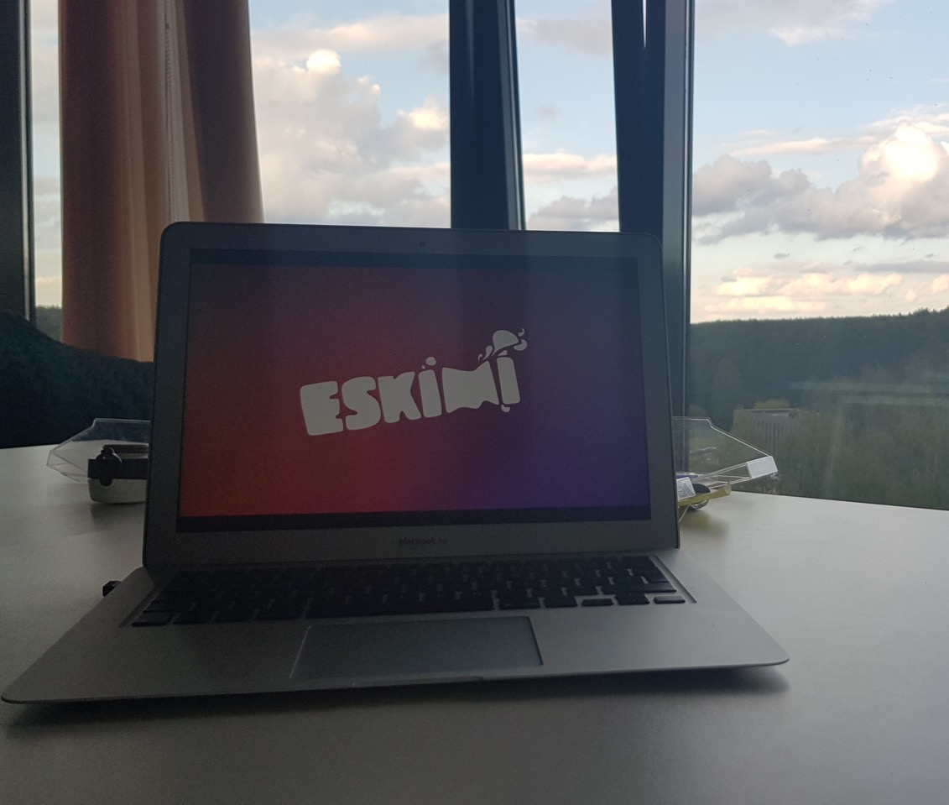

SUPPLY

Slide 10
KEY METRICS
REACH
ENGAGEMENT
INVENTORY
DATA
1B+
150B+
2.2M+
100s
PROFILED USERS
IMPRESSIONS
APPS & SITES
DATA STORIES

Slide 11



WHY CAUDI HAS HIGHEST REACH
1. WIDE PROGRAMMATIC NETWORK
2. API INTEGRATION WITH OTHER PLATFORMS
More websites and apps on the network (google is part of our inventory)
can be a single view platform for
all media buying
50+ supply
sources
…

Slide 12
TARGETING OPTIONS
PLACEMENT
DEMOGRAPHICS
TECH
BEHAVIOURAL
BROWSER
OS
OPERATOR
3G/4G/WiFi
DEVICE BRAND & MODEL
PRICE RANGES
…
INTERESTS
LANGUAGE
RETARGETING
USERS LISTS
VISITED SITES&APPS
VISITED LOCATIONS
GEOFENCE
SOCIOECONOMIC CLASS
EXCHANGE
APPS OR SITES
POSITION
TIME
…
AGE
GENDER
LOCATION
HYPER-LOCATION
…

Slide 13

Target audience unique points
Traveling
UAE
BUSINESS STARTUP
Business Type
B2B
Interests
Investment
Business Investor
Business
News
Technology

Slide 14
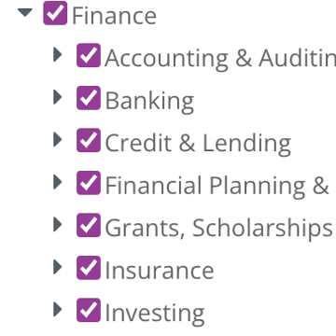
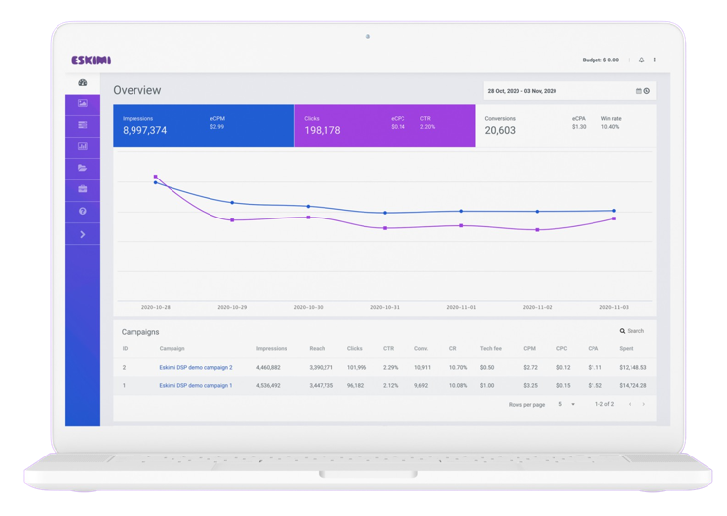
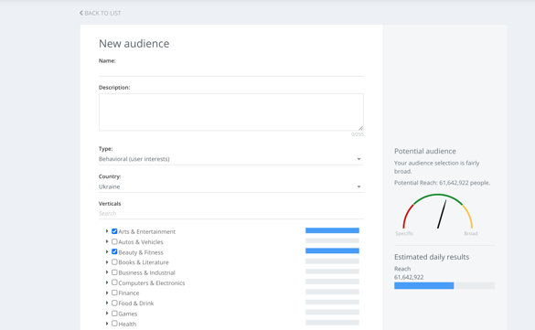


INTEREST TARGETING
People are targeted based on their interests.
Caudi collects first party data from users’ browsing activities.
Reach Your Right Audience
Behavioral Targeting
Finance interests
Business interests
Tech interests

Slide 15
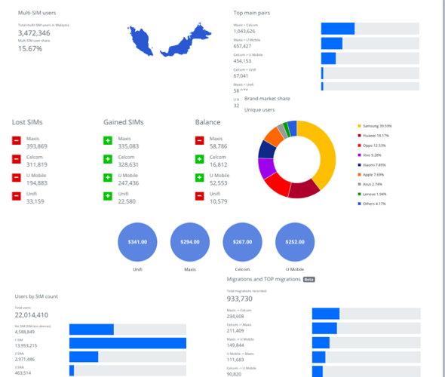
DATA

Slide 16
WHAT DATA WE COLLECT
TRAVEL STATUS
CONTENT USED
ISP USED
LOCATION TAGS
DEVICE
SOCIO_ECONOMIC CLASS
DMP
MULTI-SIM’S
DATA CONSUMPTION
SITE VISITS
SOURCES: PUBLISHER DATA, EXTERNAL PROVIDERS, BANNER TAGS, LEARNING TAGS

Slide 17




DATA STORIES
A set of business rules to create audience segment based on factual data and not predictive algorithms.
Create relevant data stories for largest demand brands to pitch the upper-funnel story.
Our data points
Usual data points
MALE
PARENT
LIVES IN ZAMBIA
AGE 29-34
RECENTLY VISITED HOSPITAL
INTERESTED IN HEALTH
MULTI-SIM
SPORTS FAN
HIGH DATA CONS.
$650 DEVICE
TRAVELS
USES MTN
LIVES IN KABWATA
HAS A CAR
FIBER AT HOME

Slide 18
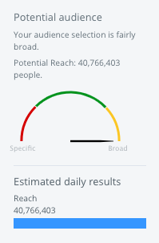
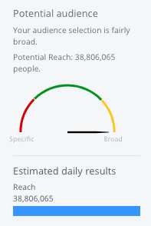
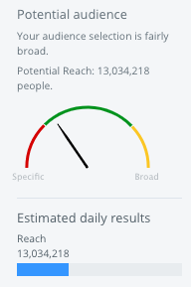
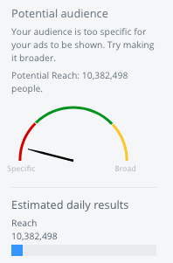
INTERESTS TARGETING
People are targeted based on their interests. Our DMP collects first party data from users browsing activities.
ENTERTAINMENT
COMPUTER & ELECTRONICS
TRAVELING
AUTOMOTIVE

Slide 19

LANGUAGE
TARGETING
Language targeting allows you to choose the language of the potential customers you'd like to reach. We'll show your ads to customers who uses devices or visit sites and apps in that same language.

Slide 20
AGENDA
Language Targeting & data
Quality sites & apps
Key Metrics and Device IDs
Campaign strategy
Creative strategy
GROW
&
Latest market data
Unique solutions

Slide 21

Language Targeting
Devices detected using Russian Language in UAE.
Caudi Technologies has detected 248,000 active devices using Russian Language only in UAE

Slide 22
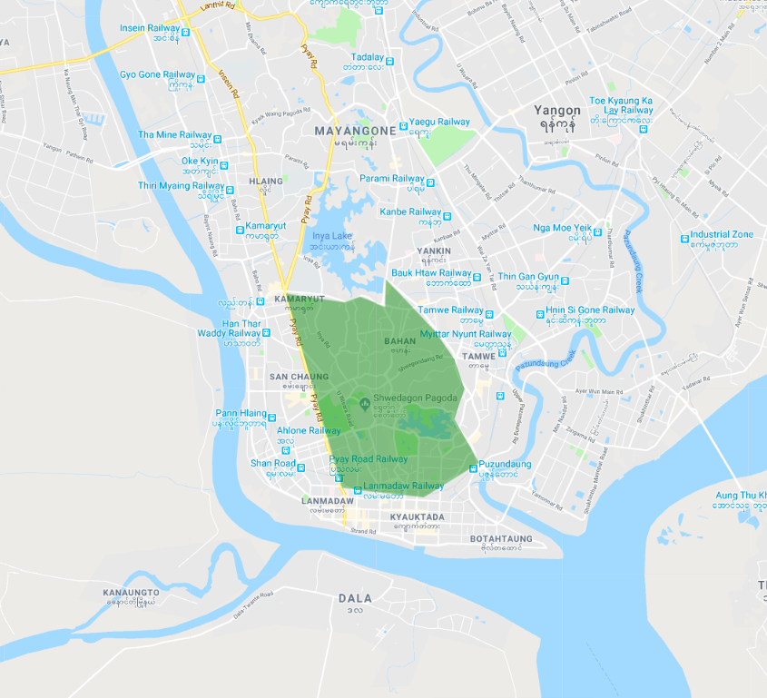
HYPER LOCAL TARGETING
— Travel
— Shopping malls
— Petrol stations
— Fast food chains
— Specific districts

Slide 23
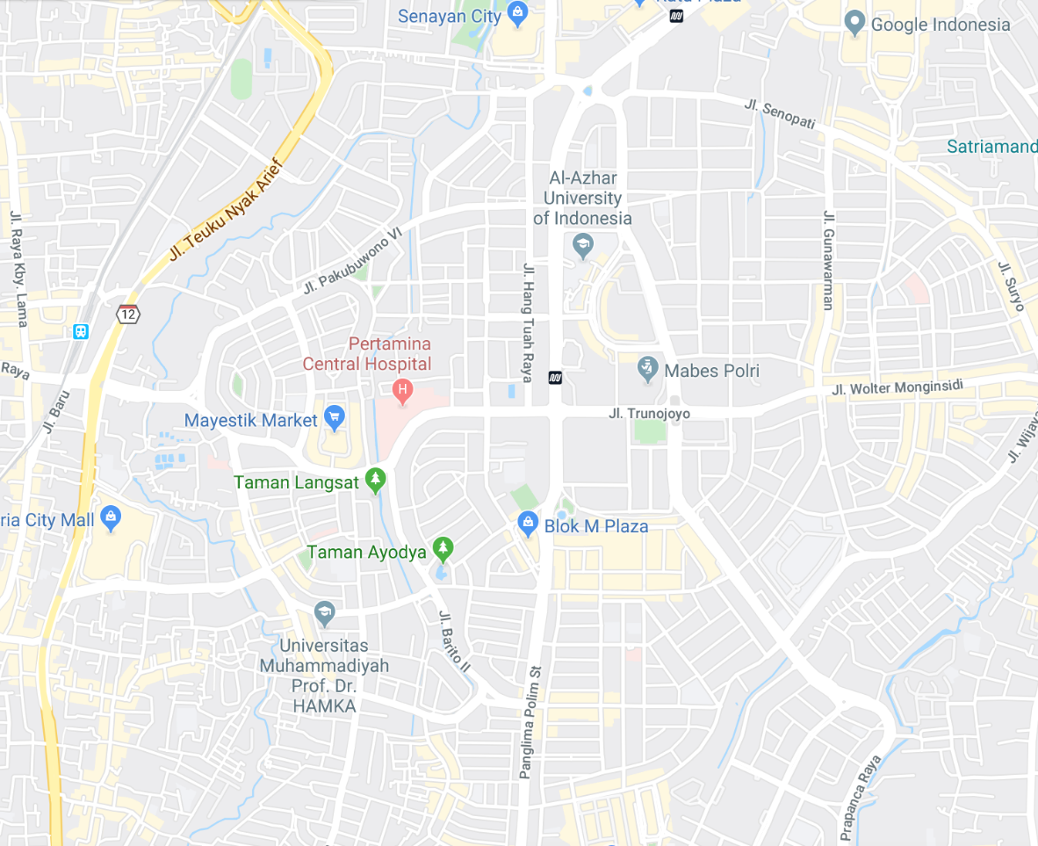
FOOTFALL TRACKING
Track how many users who viewed your ad via our DSP, has visited a physical location like:
restaurant
hotel
shop
event, etc.
See which campaign drives more potential clients to your business
Understand your return on investment (ROI)

Slide 24
OUTDOOR AUDIENCE TARGETING
Our DSP geofence client outdoor advertising points around the city or country.
User will be seeing synchronized advertising if he is browsing while passing by the outdoor ads.

Slide 25

AUDIENCE COLLECTION

Slide 26
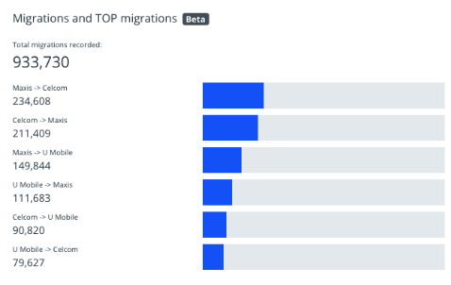
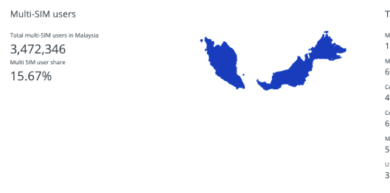
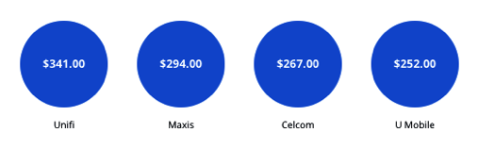
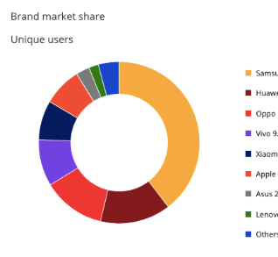
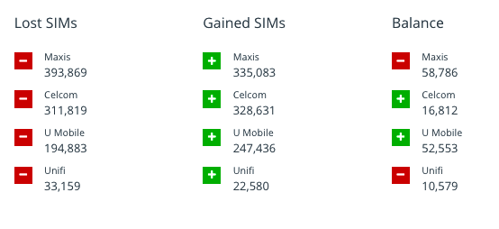
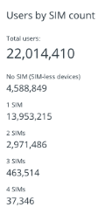
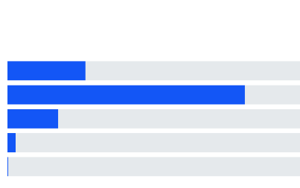
WE BUILD UNIQUE MARKET RESEARCH DASHBOARD

Slide 27
TELECOM RESEARCH DASHBOARD

Slide 28
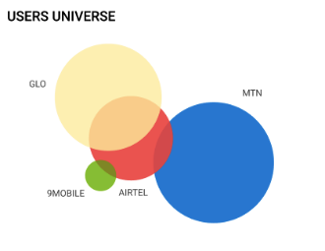
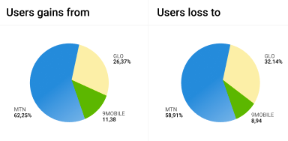
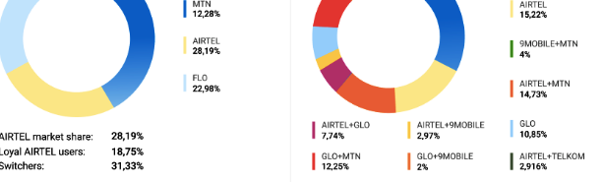
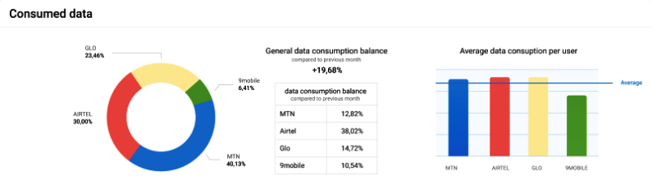
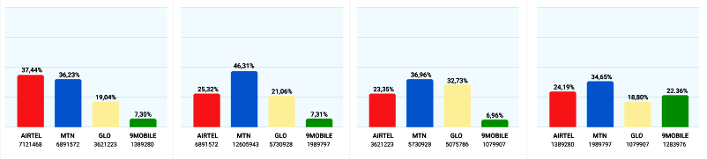
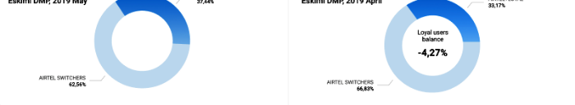
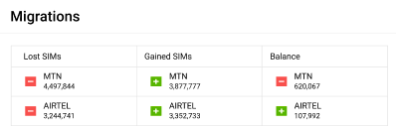
DEEP INSIGHTS TO OPERATOR MARKET SHARE & MULTI-SIM PAIRS

Slide 29
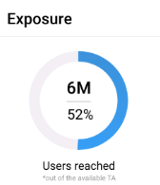
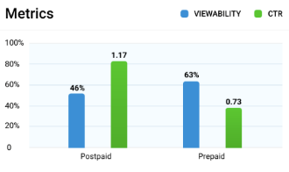
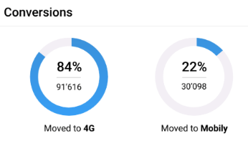
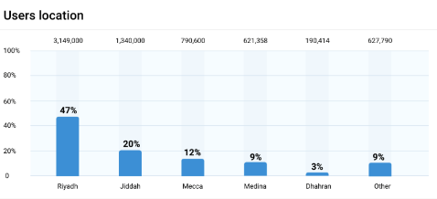
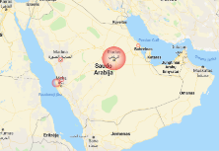
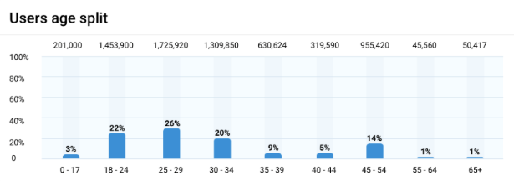
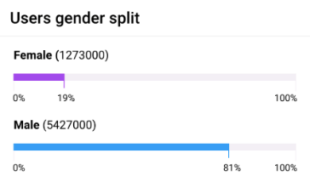
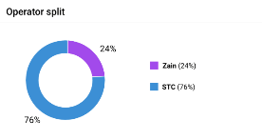
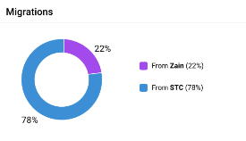
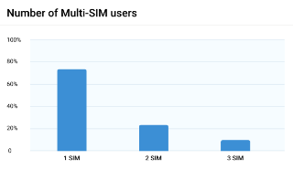
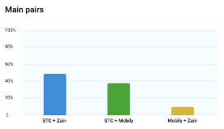
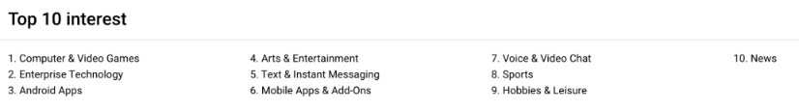
WE TRACK POST CAMPAIGN IMPACT
Converted

Slide 30
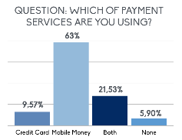
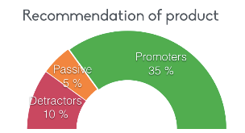
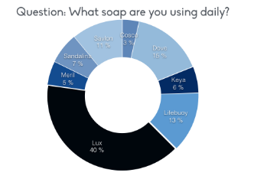
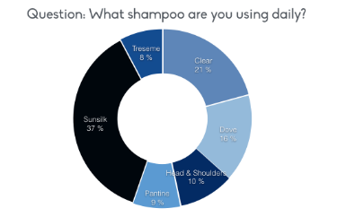
ENRICHED ONLINE SURVEYS
We run surveys with enriched DMP Data.
Measure customer satisfaction
Determine customer loyalty
Identify week and strong spots of your product
Learn customer behaviour patterns
Measure campaign impact

Slide 31
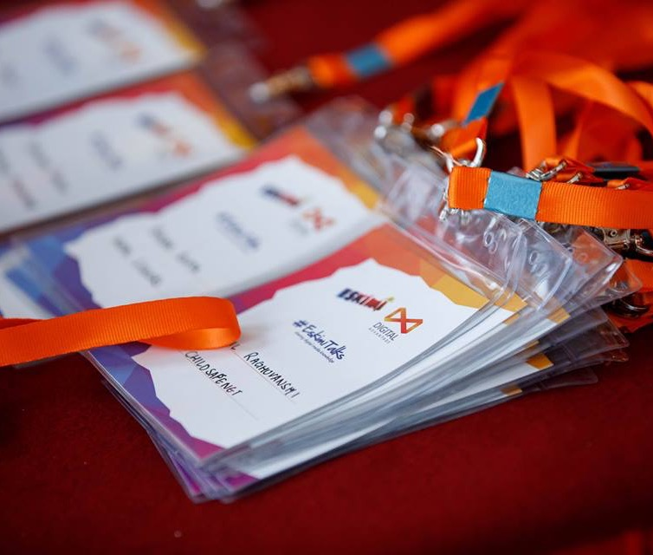
CREATIVES

Slide 32
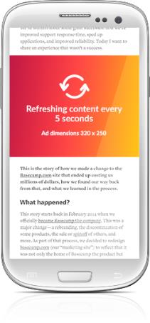
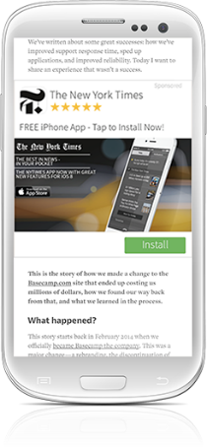
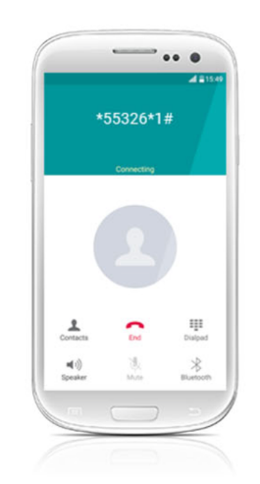
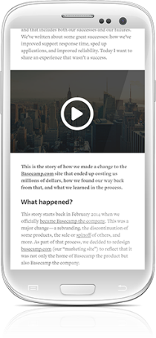
ALL AD TYPES
CLICK-TO-ACTION
INTERACTIVE
VIDEO
STANDARD IMAGE / .GIF
DYNAMIC
NATIVE

Slide 33



DATA DRIVEN & RICH MEDIA CREATIVES
SCRATCH
SWIPE
DRAG
DYNAMIC
GAMES
ANIMATED
SPEED TEST
GRAVITY
SHAKE
TOUCH
COUNTDOWN

Slide 34

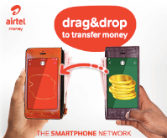


INTERACTIVE ADS + HTML EXPERTISE
SWIPE TO FILL THE GLASS
DRAG AND DROP
SHAKE YOUR PHONE
Customized Rich media solutions including development.

